Slide 1
Grafiske brugergrænseflader i F#
Programmering og problemløsning
Jon Sporring

Slide 2
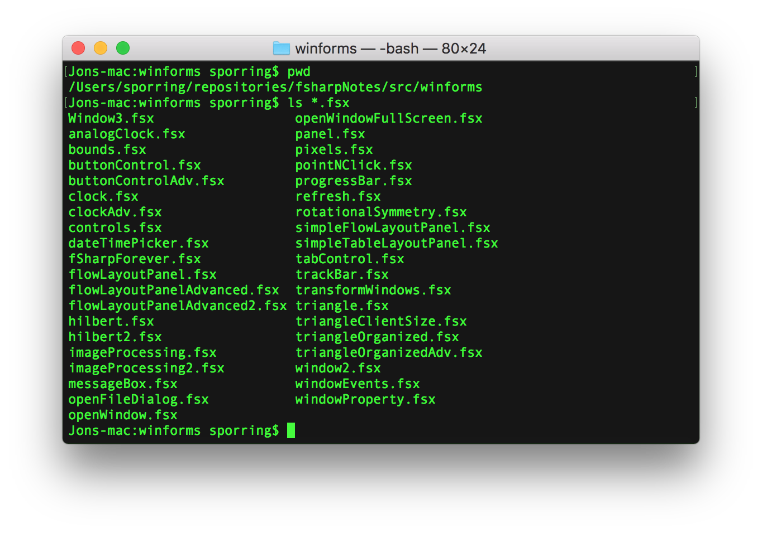
Kommandolinjen

Slide 3
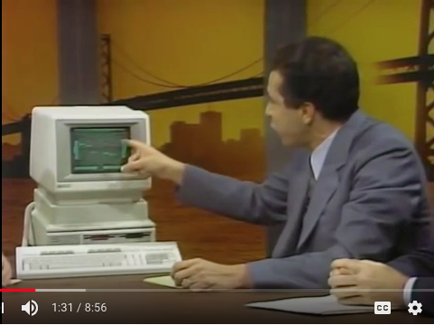
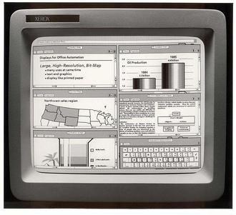
Douglas Engelbart’s mouse, 1963,
wikipedia
Xerox Star, 1973
Macintosh 128K, 1984
Xerox 8010/40 System, 1981
Windows 1.0, 1985, wikipedia
HP Touch computer, 1983, youtube.com

Slide 4
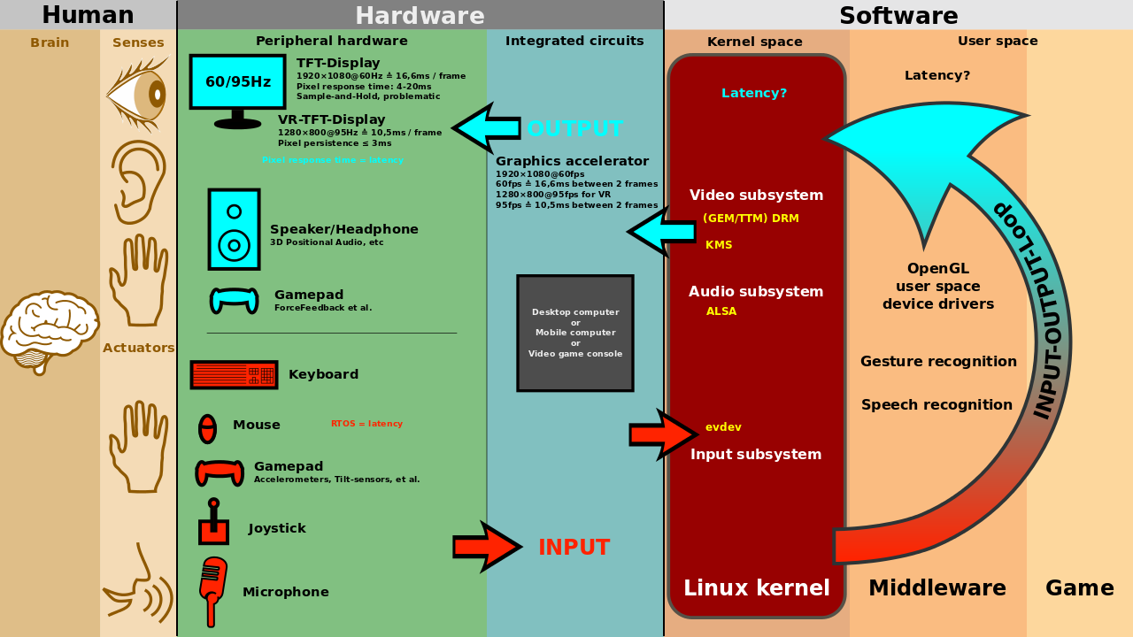
Interaktion mellem bruger, software og hardware
Bruger
Applikation
Windowsserver
Kerne
Hardware
GNU Free Documentation License, author: Shmuel Csaba Otto Traian, en.wikipedia.com, retrieved: 2018/1/10.

Slide 5
Design guidelines
Foretræk simple interfaces
Gå efter konsistens og med elementer, brugeren kender
Vælg en opsætning, som fremhæver de vigtigeste elementer
Brug farve og teksturer strategisk
Vær konservativ mht. font, størrelse og form
Gør brugeren opmærksom på, hvad der sker
Tænk på default værdier

Slide 6
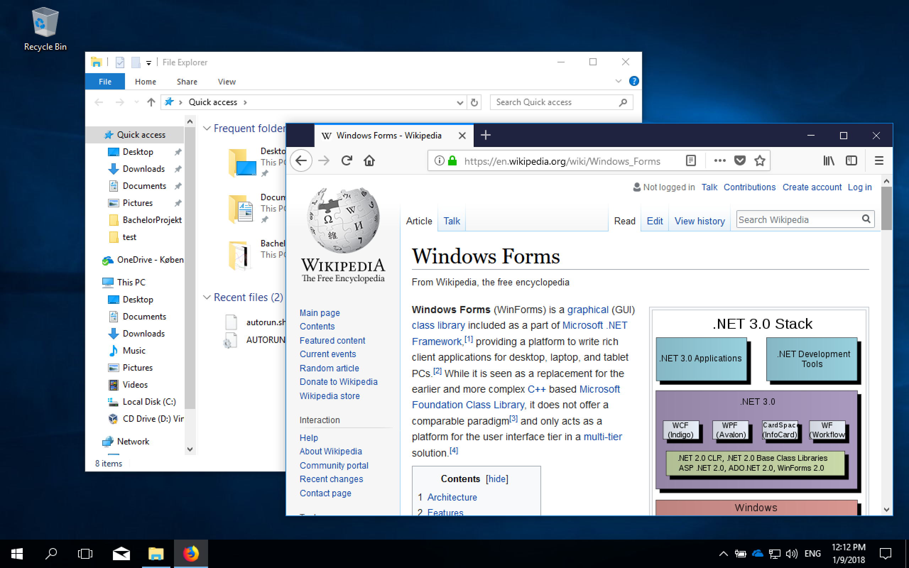
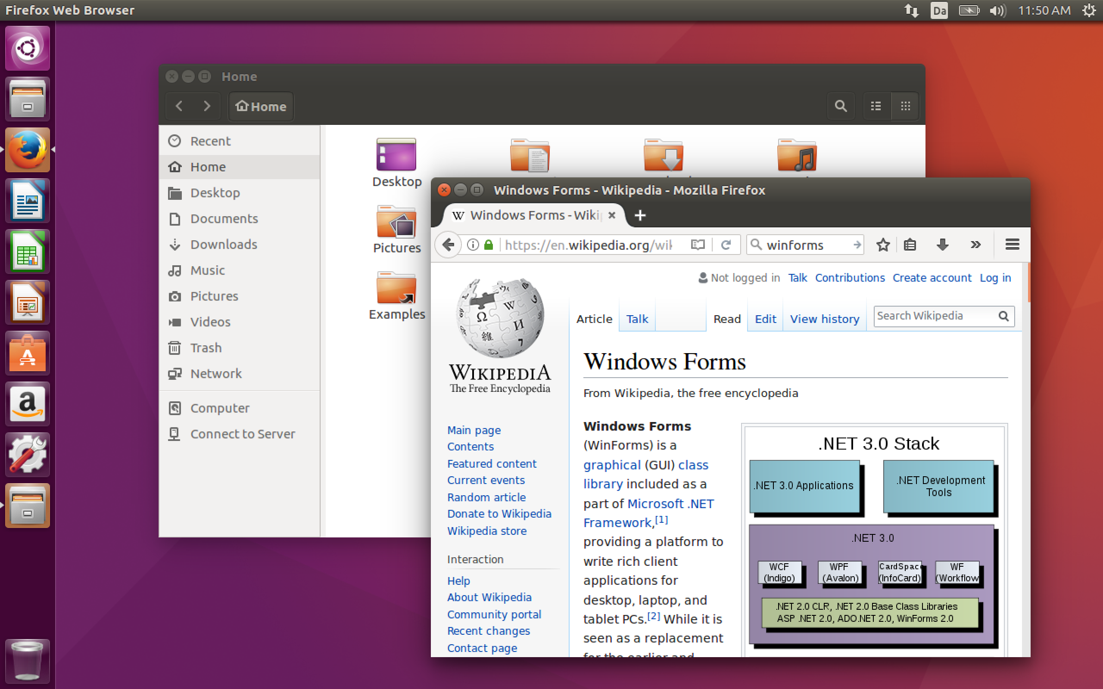
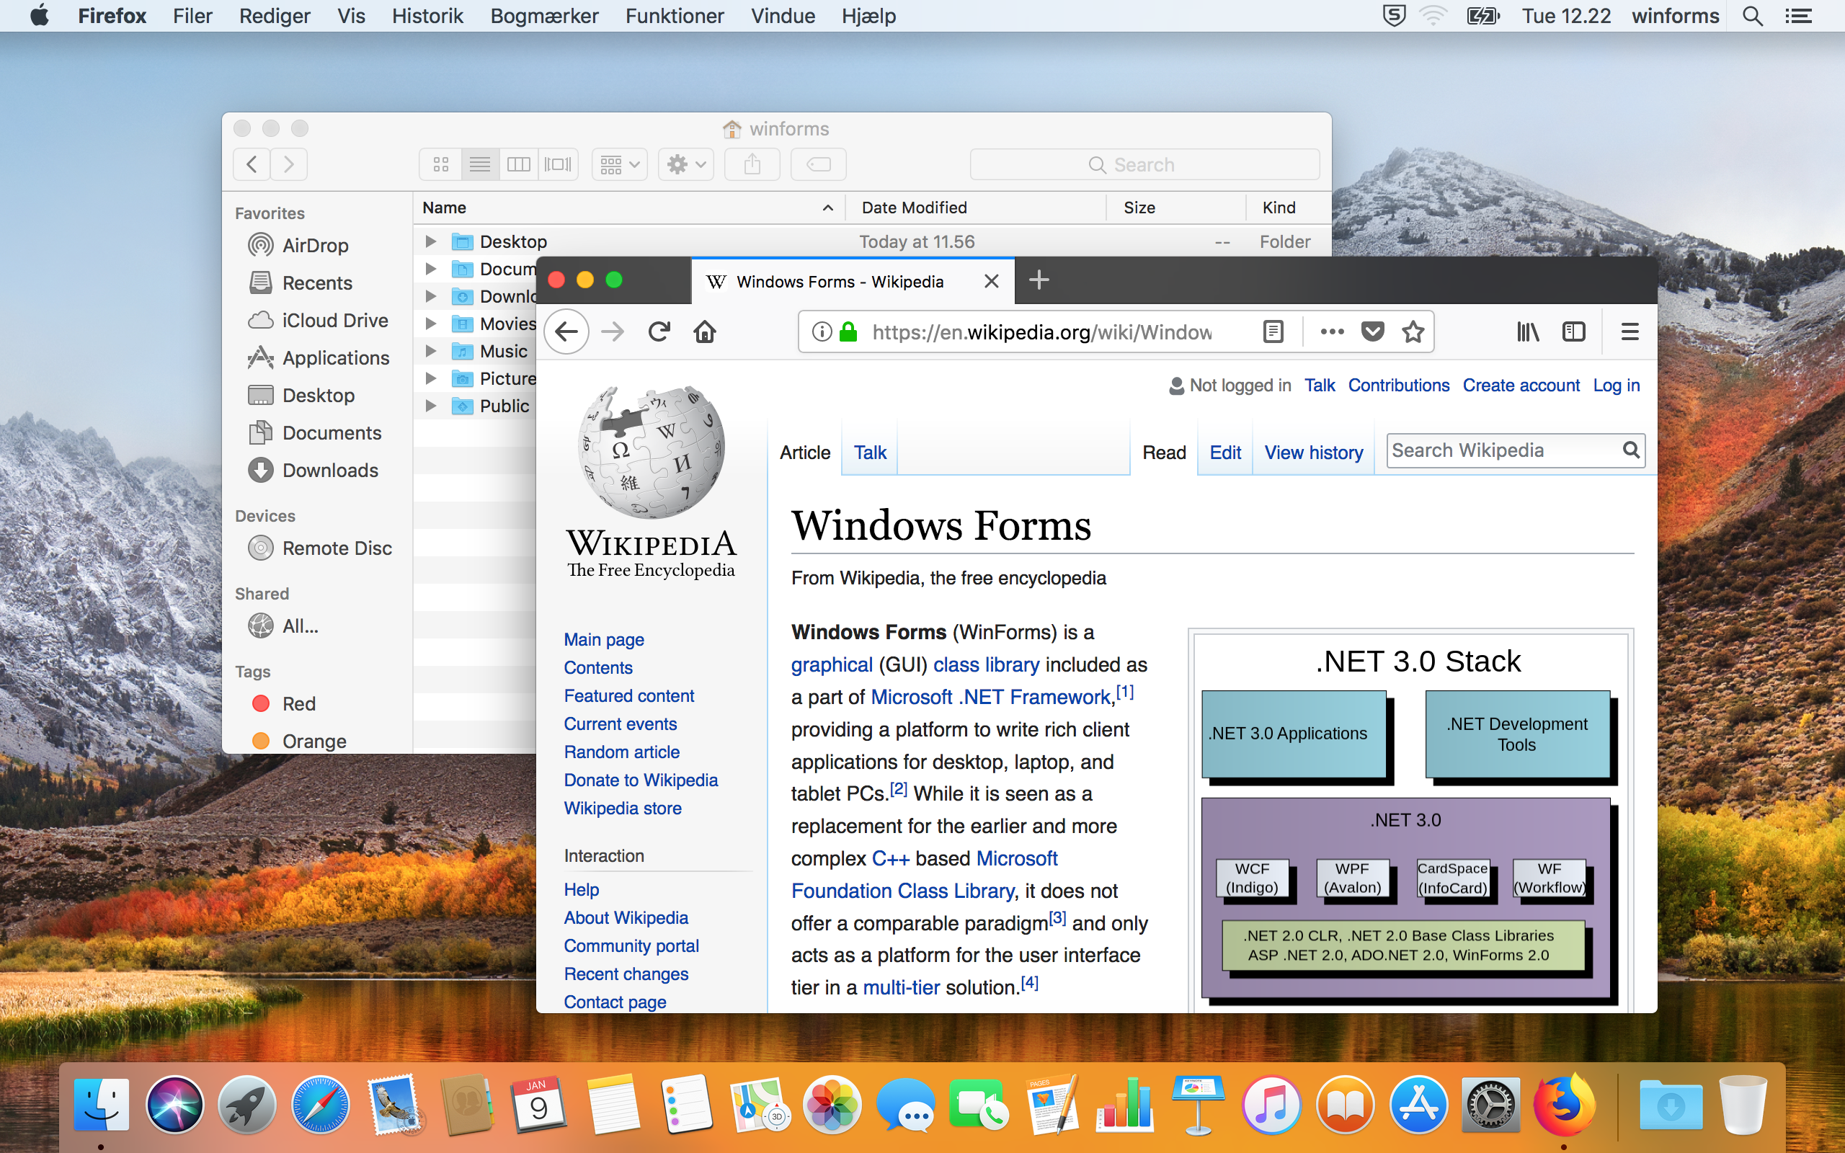
Grafiske brugergrænseflader
Windows 10
Ubuntu 16.04
MacOs 10.13

Slide 7
Windows and libraries for Mono
WinForms 2.0 (.Net, MS Windows, DirectX vs. GDI+, Windows Presention Foundation)
Gtk# (Gtk+, Linux/Gnome)
Cocoa (MacOS)

Slide 8
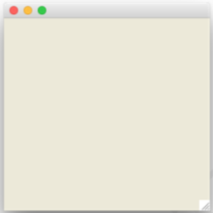
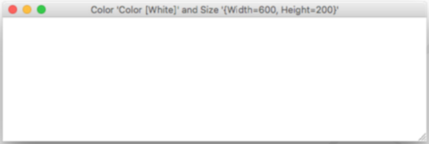
My first window
openWindow.fsx
// Create a window
let win = new System.Windows.Forms.Form ()
// Start the event-loop.
System.Windows.Forms.Application.Run win
windowProperty.fsx
// Prepare window form
let win = new System.Windows.Forms.Form ()
// Set some properties
win.BackColor <- System.Drawing.Color.White
win.Size <- System.Drawing.Size (600, 200)
win.Text <- sprintf "Color '%A' and Size '%A'" win.BackColor win.Size
// Start the event-loop.
System.Windows.Forms.Application.Run win

Slide 9
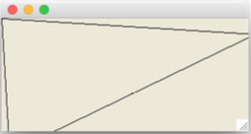
Tegne call-back funktionen
triangle.fsx
// Open often used libraries, beware of namespace polution!
open System.Windows.Forms
open System.Drawing
// Prepare window form
let win = new Form ()
win.Size <- Size (320, 170)
// Set paint call-back function
let paint (e : PaintEventArgs) : unit =
printfn "redrawing"
let pen = new Pen (Color.Black)
let points =
[|Point (0,0); Point (10,170); Point (320,20); Point (0,0)|]
e.Graphics.DrawLines (pen, points)
win.Paint.Add paint
// Start the event-loop.
Application.Run win

Slide 10
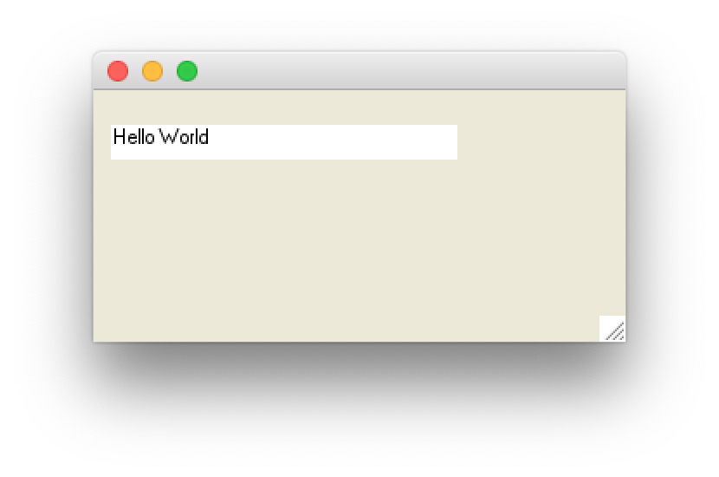
Skrive på skærmen
label.fsx
open System.Windows.Forms
open System.Drawing
let win = new Form () // make a window form
win.ClientSize <- Size (200, 100)
// make a label to show time
let label = new Label()
win.Controls.Add label
label.Width <- 200
label.Location <- new Point (10, 20)
label.Text <- "Hello World"
label.BackColor <- Color.White
label.Height <- 20
Application.Run win // start event-loop

Slide 11
System.Timers
fsharpi
let t = new System.Timers.Timer()
t.Interval <- 1000.0
t.Elapsed.Add (fun e -> printfn "%s" (string System.DateTime.Now));;
t.Start();;
t.Stop();;

Slide 12
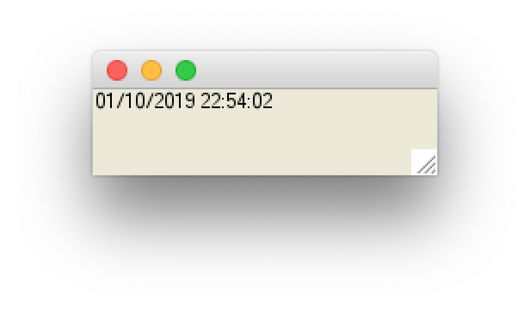
System.Windows.Forms
clock.fsx
open System.Windows.Forms
open System.Drawing
let win = new Form () // make a window form
win.ClientSize <- Size (200, 50)
// make a label to show time
let label = new Label()
win.Controls.Add label
label.Width <- 200
label.Text <- string System.DateTime.Now // get present time and date
// make a timer and link to label
let timer = new Timer()
timer.Interval <- 1000 // create an event every 1000 millisecond
timer.Enabled <- true // activiate the timer
timer.Tick.Add (fun e -> label.Text <- string System.DateTime.Now)
Application.Run win // start event-loop

